Slide 1

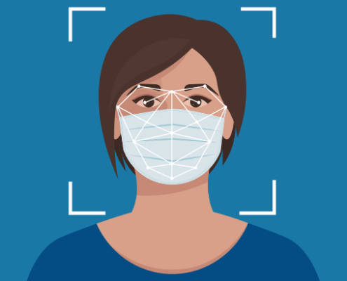
FACE MASK
DETECTION MASTER

Slide 2






OUR TEAM
SAMIR
CHOUDHURY
SUBHASIS
PATABANDHA
TUSHAR KANTA BIHARI
19IMCA041
19IMCA049
19IMCA060

Slide 3
INTRODUCTION
AS WE NAVIGATE THROUGH THE CHALLENGES POSED BY THE COVID-19 PANDEMIC, TECHNOLOGIES LIKE FACE MASK DETECTION PLAY A CRUCIAL ROLE IN ENSURING PUBLIC HEALTH AND SAFETY. IN THIS PRESENTATION, I'LL BE SHARING INSIGHTS INTO OUR PROJECT'S DEVELOPMENT, AND ITS SIGNIFICANCE.

Slide 4
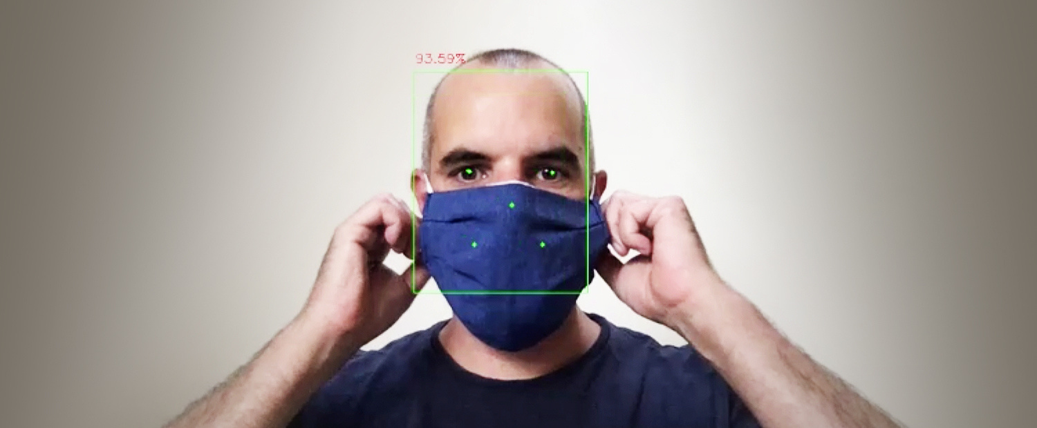
OBJECTIVES AND GOALS
Detection Accuracy
Developing a model capable of accurately detecting whether a person in an image or video is wearing a face mask or not. High detection accuracy is essential for reliable results and effective monitoring.
Real-time Performance
Ensuring that the detection system operates in real-time, allowing for timely intervention or alerts when individuals are not wearing masks in designated areas. Real-time performance enhances the system's usability and practicality in various settings.

Slide 5
OBJECTIVES AND GOALS
Contribution to Public Safety
Contributing to the creation of a safer society by promoting adherence to mask-wearing guidelines. By accurately identifying individuals who are not wearing masks, the system can help mitigate the spread of infectious diseases and protect public health.

Slide 6
SOFTWARE RQUIREMENTS
WINDOWS 7 OR ABOVE
PYTHON (VERSION 3.5 OR HIGHER)
HARDWARE REQUIREMENTS
PROCESSOR (CPU): INTEL CORE I3-7TH GEN OR AMD RYZEN
3 3RD GEN (OR EQUIVALENT)
MEMORY (RAM): 4GB RAM OR MORE
STORAGE (ROM): 128 GB OR MORE
WEBCAM : 480P RESOLUTION OR MORE

Slide 7

TECHNOLGIES USED
PYTHON
FRAMEWORKS AND LIBRARIRES
TENSORFLOW
KERAS
IMUTILS
NUMPY
OPENCV-PYTHON
MATPLOTLIB
ARGPARSE
PILLOW
STREAMLIT
ONNX
TF2ONNX

Slide 8

WORK SNIPPETS

Slide 9
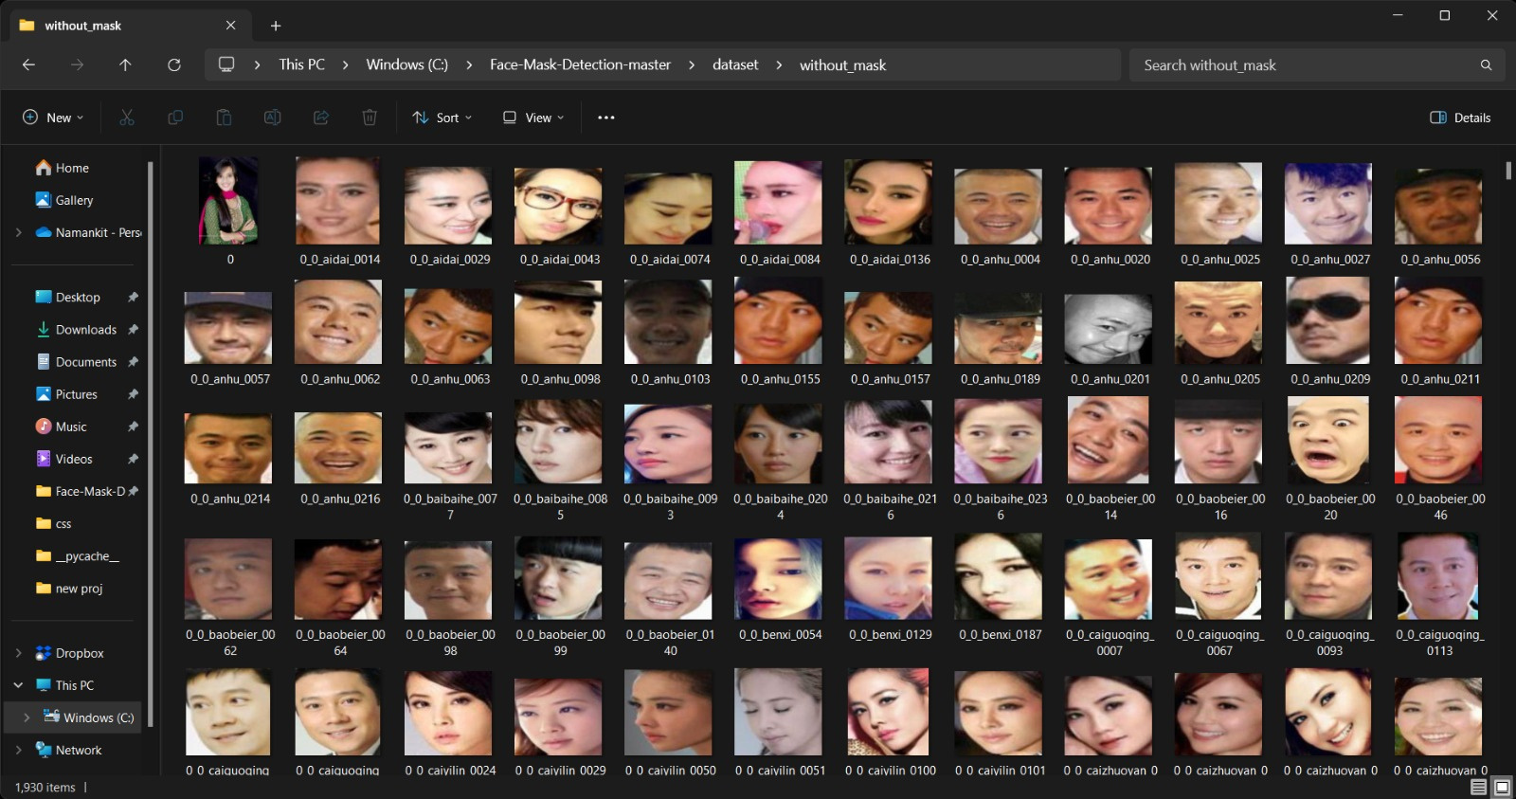
DATA PRE-PROCESSING AND CLEANING

Slide 10
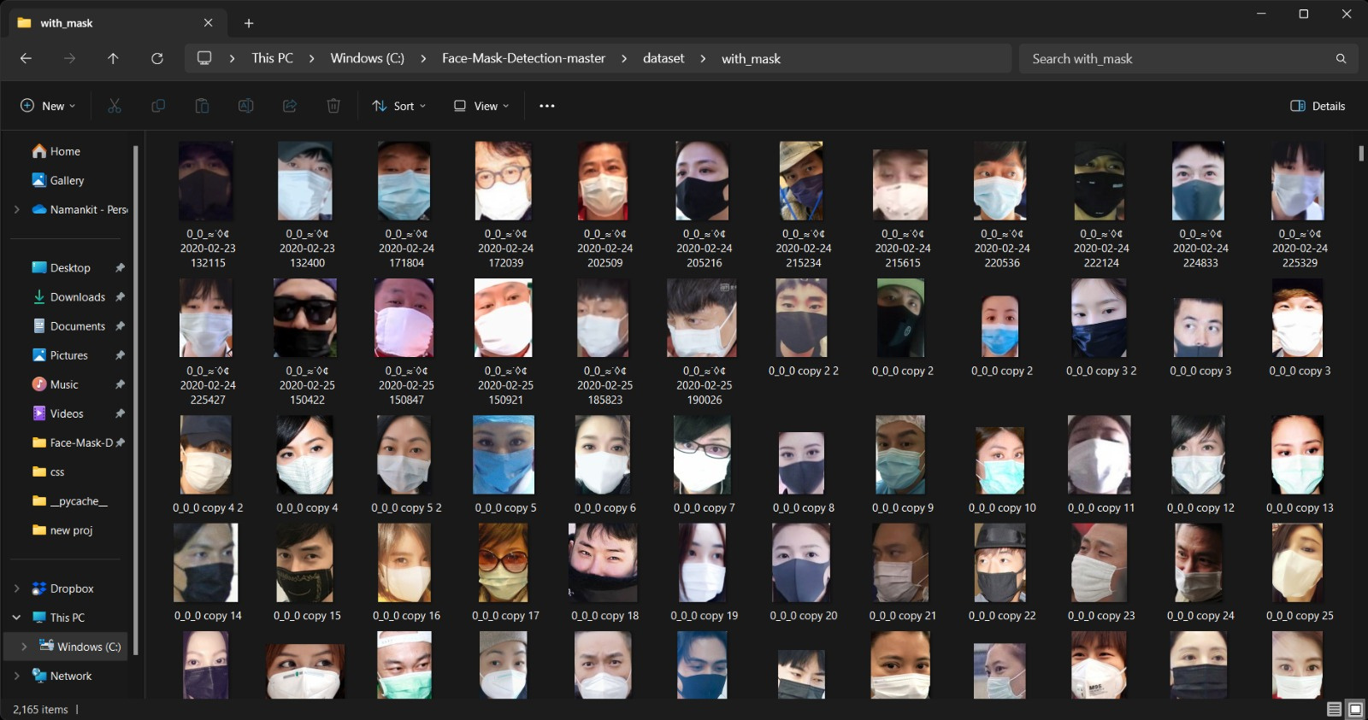
DATA PRE-PROCESSING AND CLEANING

Slide 11
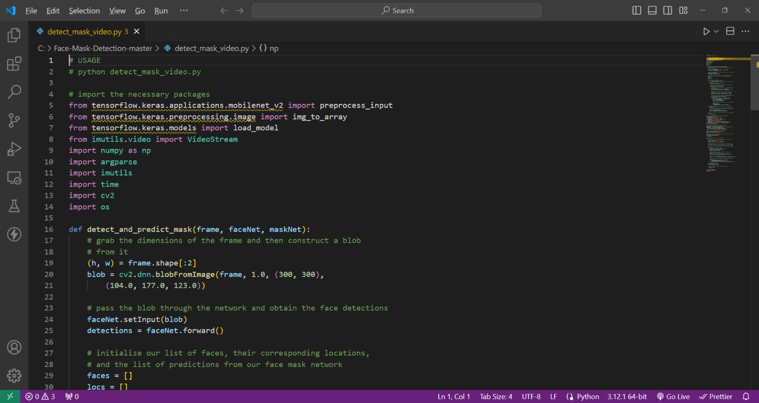
TRAINING OUR MODEL

Slide 12
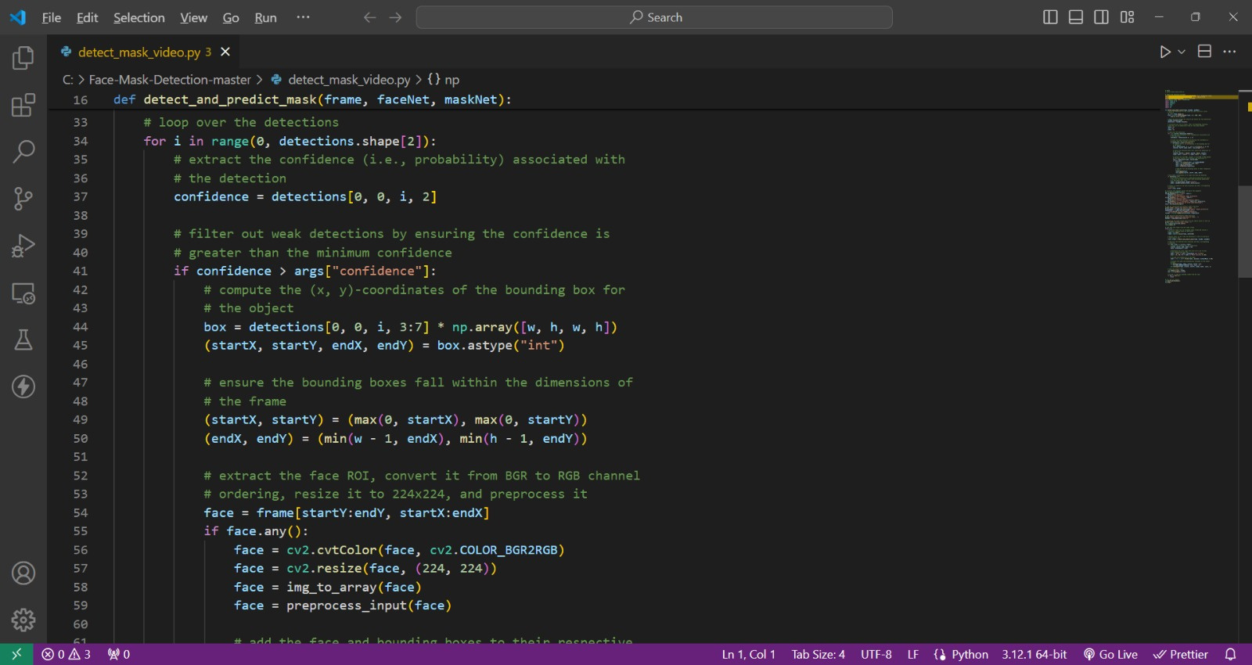
TRAINING OUR MODEL

Slide 13

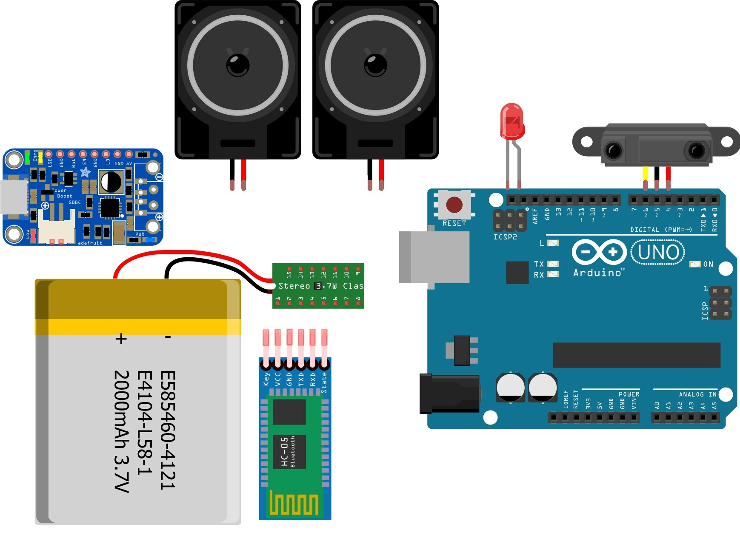

IOT INTEGRATION
We plan to integrate IoT speakers into the face mask detection system as it aims to provide immediate auditory feedback to individuals detected without masks, reinforcing adherence to safety protocols. This integration involves configuring communication protocols between the detection program and the speakers, defining alert logic to trigger beeps or pre-recorded messages upon non-compliance

Slide 14

SUMMARY
The face mask detection master program offers a robust solution for identifying individuals wearing masks in real-time, crucial for enforcing safety measures in public spaces. Leveraging machine learning techniques, the program accurately detects the presence or absence of masks in images or video streams. Integration with IoT devices, such as speakers, enhances its effectiveness by providing immediate alerts to non-compliant individuals, promoting adherence to mask-wearing guidelines.

Slide 15
FUTURE SCOPE
ENHANCED ACCURACY AND EFFICIENCY : CONTINUOUSLY TRAINING AND REFINING THE MACHINE LEARNING MODEL USING DIVERSE DATASETS AND ADVANCED ALGORITHMS TO IMPROVE ACCURACY AND EFFICIENCY IN DETECTING MASKS UNDER VARIOUS CONDITIONS AND SCENARIOS.
EXPANDED IOT INTEGRATION: EXPLORE INTEGRATING ADDITIONAL IOT DEVICES BEYOND SPEAKERS, SUCH AS TO WEARABLE DEVICES WHICH NOTIFIES WHEN SOMEONE ACCIDENTALY FORGETS WEARING THE MASK WHILE ENTERING OR INTO AN AUTOMATIC DOOR, WHICH CAN STOP THE SAID PERSON FROM ENTERING WHEN A MASK IS NOT DETECTED.
LONG TERM TRACKING AND ANALYSIS: THE MASK DETECTION PROGRAM WILL EXPAND ITS FUNCTIONALITY TO TRACK INDIVIDUALS' MASK-WEARING BEHAVIOR OVER EXTENDED PERIODS, STORING DATA IN A SECURE DATABASE FOR LONG-TERM ANALYSIS. THIS DATA WILL BE UTILIZED TO GENERATE INDIVIDUAL ACCOUNTABILITY REPORTS, PROVIDING INSIGHTS INTO COMPLIANCE TRENDS AND PATTERNS.

Slide 16

THANK YOU

